Slide 1
The Role of Disk Volatile Chemistry and Dynamics in Shaping the Compositions of Nascent Planets
Ana-Maria Piso
Advisor: Karin Öberg
Collaborators: Ruth Murray-Clay, Til Birnstiel, Ilse Cleeves
Thesis Advisory Committee: Matthew Holman, Sean Andrews, Dimitar Sasselov
TAC Meeting Presentation: April 29th, 2015
Notes:
…and what I would like to talk about today is the minimum core mass for giant planet formation. Now, when we think of minimum core mass, we think core accretion. In core accretion, we know that for a giant planet to form it needs a solid core, that grows, and once it becomes massive enough it can then accumulate a significant atmosphere. How big of a core do we need? Well, typically this value is believed to be around 10 Me. However, this is not a constant, and it not only depends on where we are in the disk but also on how fast the core grows. Now why do we care about this? We have seen throughout this week giant planets imaged at wide separations. Now, we don’t know whether these planets formed through core accretion or not; but if they do, and if core accretion works at large separations, then it’s very important to understand how it works, and more importantly to be able to place a robust absolut minimum for a giant planet to form within the lifetime of the protoplanetary disk. And this is what I am going to talk about today.

Slide 2
Outline
The disk-planet connection
Previous Research: Minimum Core Masses for Planet Formation
Protoplanetary disk compositions
Proposed Research
Radial drift of solids, snowline locations and C/O ratios
Chemical effects
4. Preliminary Results
5. Proposed Completion Timeline

Slide 3
Outline
The disk-planet connection
Previous Research: Minimum Core Masses for Planet Formation
Protoplanetary disk compositions
Proposed Research
Radial drift of solids, snowline locations and C/O ratios
Chemical effects
4. Preliminary Results
5. Proposed Completion Timeline

Slide 4
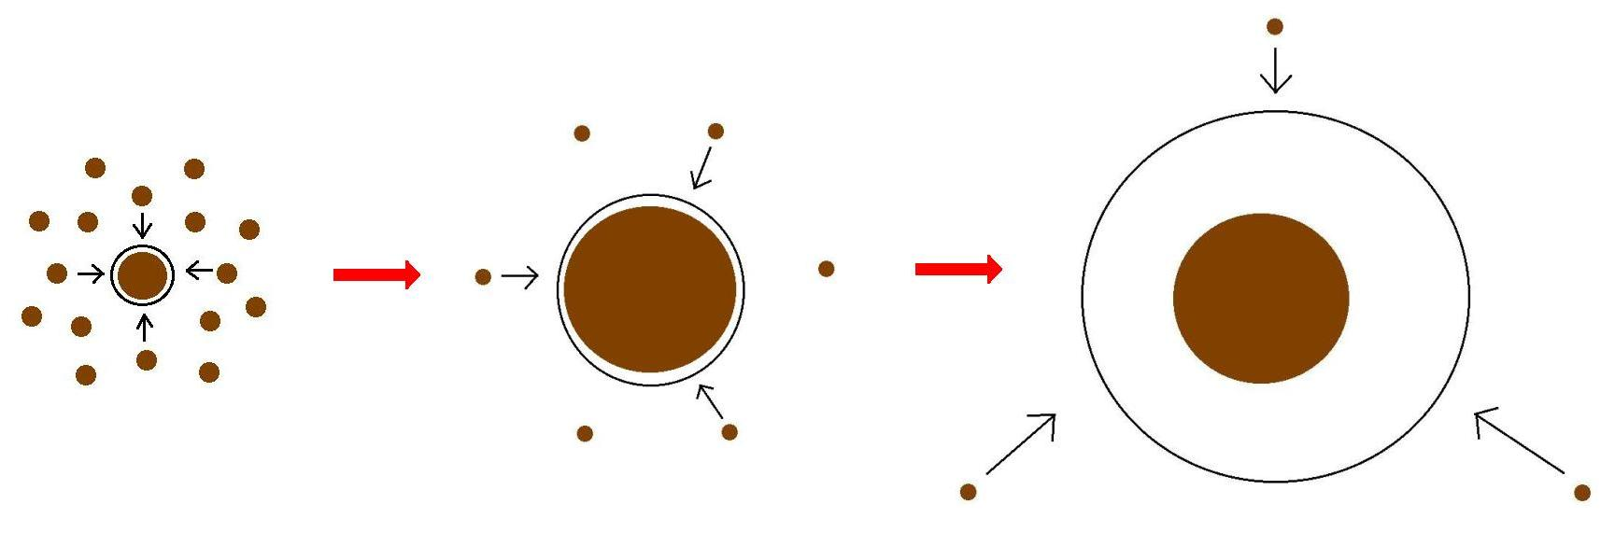
Core Accretion Model
The composition of planets is determined by and tightly linked to the disk composition

Slide 5
Outline
The disk-planet connection
Previous Research: Minimum Core Masses for Planet Formation
Protoplanetary disk compositions
Proposed Research
Radial drift of solids, snowline locations and C/O ratios
Chemical effects
4. Preliminary Results
5. Proposed Completion Timeline

Slide 6
Research Project: Minimum Core Masses for Giant Planet Formation
Supervised by Dr. Andrew Youdin and Dr. Ruth Murray-Clay
Has resulted in two first-author publications:
Ana-Maria A. Piso and Andrew N. Youdin, On the Minimum Core Mass for Giant Planet Formation at Wide Separations. ApJ, 2014, 786, 21
Ana-Maria A. Piso, Andrew N. Youdin, and Ruth A. Murray-Clay, Minimum Core Masses for Giant Planet Formation with Realistic Equations of State and Opacities. Apj, 2015, 800, 82

Slide 7
GOAL
Determine the minimum core mass, M_{crit}, to form a giant planet during the disk lifetime in the low planetesimal accretion regime when atmosphere dominated by KH contraction
Calculate M_{crit} with
REALISTIC EQUATION OF STATE (EOS)
REALISTIC DUST OPACITIES
Notes:
Why Lacc=0?
- to get around the difficulty to form a giant planet a large distances throigh core acc
- you can depleted zone of planetesimals
- move the core

Slide 8
Variations in due to non-ideal EOS effects INCREASE M_{crit}
ad
t_disk ~ 3 Myr, ISM opacity
Piso, Youdin, & Murray-Clay (2015)
Notes:
Here I am plotting the critical core mass as a function of semimajor axis for an ideal diatomic gas. So you can see already that this value is smaller than the standard 10 Me even in the more inner parts of the disk; in a few moments I will show how this critical core mass compares to results from standard studies. But let’s first see what Mcrit depends on.

Slide 9
Grain growth opacity DECREASES M_{crit}
dN/ds ~ s^{-p}
p = 3.5
s_{max} = 1 cm
M_{crit}:
~8 M_{E} @ 5 AU
~5 M_{E} @ 100 AU
t_disk ~ 3 Myr, realistic EOS
Piso, Youdin, & Murray-Clay (2015)

Slide 10
Coagulation p=2.5 may decrease M_{crit} by up to one order of magnitude!
M_{c} = 4 M_{E}
Realistic EOS
Piso, Youdin, & Murray-Clay (2015)

Slide 11
Summary
H₂ dissociation and variable occupation of H₂ rotational states INCREASE M_{crit} when compared to an ideal gas polytrope
Grain growth opacity DECREASES M_{crit} compared to ISM opacity
M_{crit} ~ 8 M_{E} at 5 AU and ~ 5 M_{E} at 100 AU for a realistic EOS with H₂ spin isomers in thermal equilibrium and grain growth opacity with standard collisional cascade (p=3.5) and s_{max}=1 cm
M_{crit} may decrease by up to one order of magnitude if coagulation is taken into account (p=2.5)

Slide 12
Outline
The disk-planet connection
Previous Research: Minimum Core Masses for Planet Formation
Protoplanetary disk compositions
Proposed Research
Radial drift of solids, snowline locations and C/O ratios
Chemical effects
4. Preliminary Results
5. Proposed Completion Timeline

Slide 13
BASIC IDEA
Understand the disk well enough to:
Predict what kind of planet compositions result from planet formation in different parts of the disk
Back-track the planet formation location based on the planet composition

Slide 14
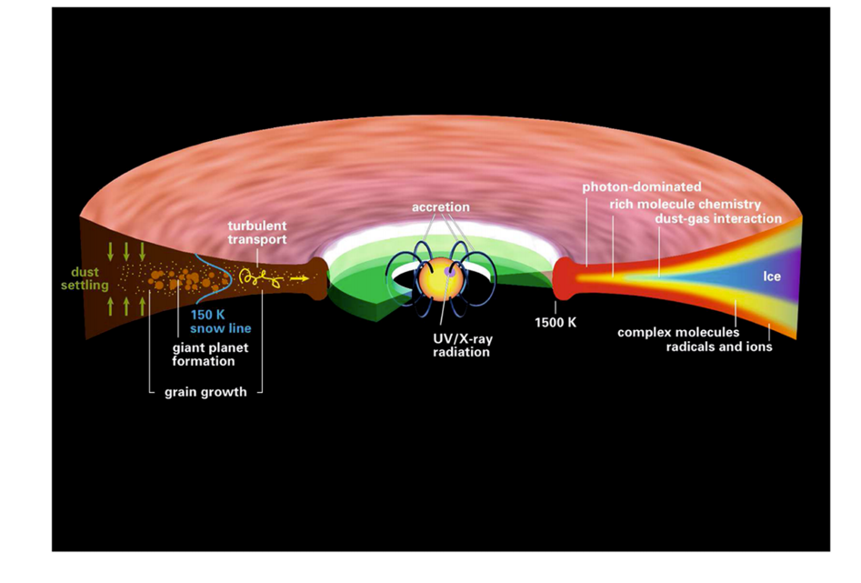
Disk structure is complex!
Henning&Semenov (2013)

Slide 15
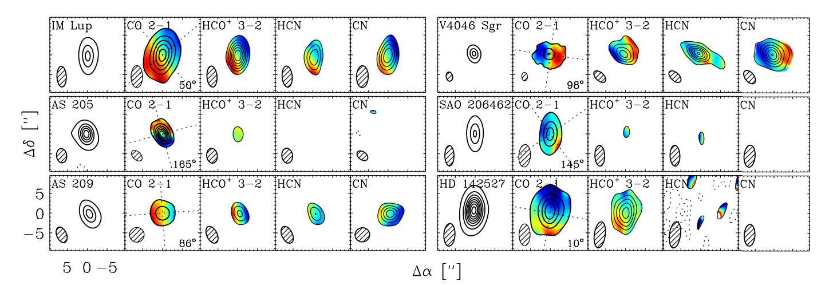
Volatile compounds have been detected in the outer regions of protoplanetary disks
Oberg+11

Slide 16
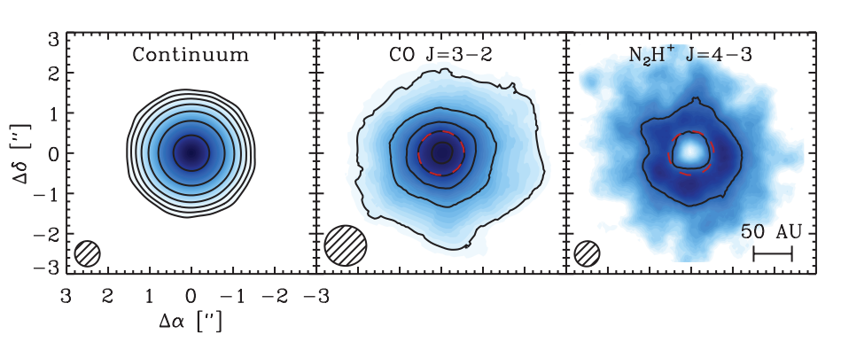
Snowlines of volatile molecules have been detected in disks
Qi+13

Slide 17
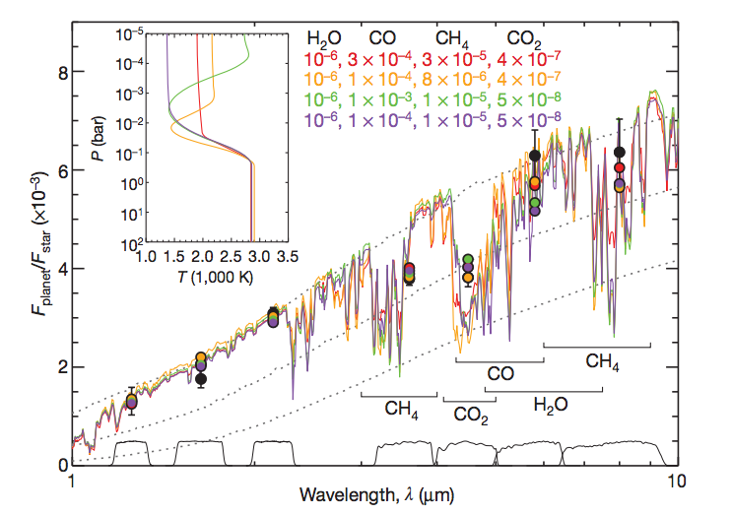
C/O ratio is an important signature of atmospheric chemistry
Some giant planets have C/O ratios different from the stellar value of 0.54
Madhusudhan+11

Slide 18
WHY?
Possible explanation: main carriers of C and O, i.e. H2O, CO2 and CO, have different condensation temperatures => variations in the abundances of C and O in solids and gas between the snow lines of these volatiles

Slide 19
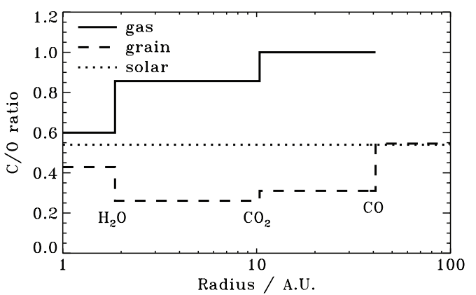
Oberg+11
After Oberg+11

Slide 20
Additional chemical and dynamical processes affect C/O ratios in disks and disk chemistry
The chemical composition and distribution of the main C and O carriers evolves with time (e.g., Vissser+09)
Locations and shapes of snowlines evolve with time (e.g., Garaud & Lin 2007)
Solids are redistributed throughout the protoplanetary disk due to radial drift (Chiang & Youdin 2010)
Sun-like stars actively accrete gas from the disk (e.g., Hartmann+06)

Slide 21
GOAL
Explore and understand each of these processes, and their relative importance in shaping disk compositions throughout time

Slide 22
Outline
The disk-planet connection
Previous Research: Minimum Core Masses for Planet Formation
Protoplanetary disk compositions
Proposed Research
Radial drift of solids, snowline locations and C/O ratios
Chemical effects
4. Preliminary Results
5. Proposed Completion Timeline

Slide 23
Outline
The disk-planet connection
Previous Research: Minimum Core Masses for Planet Formation
Protoplanetary disk compositions
Proposed Research
Radial drift of solids, snowline locations and C/O ratios
Chemical effects
4. Preliminary Results
5. Proposed Completion Timeline

Slide 24
Observations show that C/O ratios in giant planet atmospheres are different from stellar
After Oberg+11

Slide 25
Radial drift of solids
Gas moves at sub-Keplerian velocity:
v_{gas} ~ v_{K} (1-c_{s}² / v_{k}²)
Small particles (~micron size) move with the gas
Large particles (~km size) are unaffected by gas drag
“Intermediate sized” particles (~cm-m size) experience a headwind and drift towards the star

Slide 26
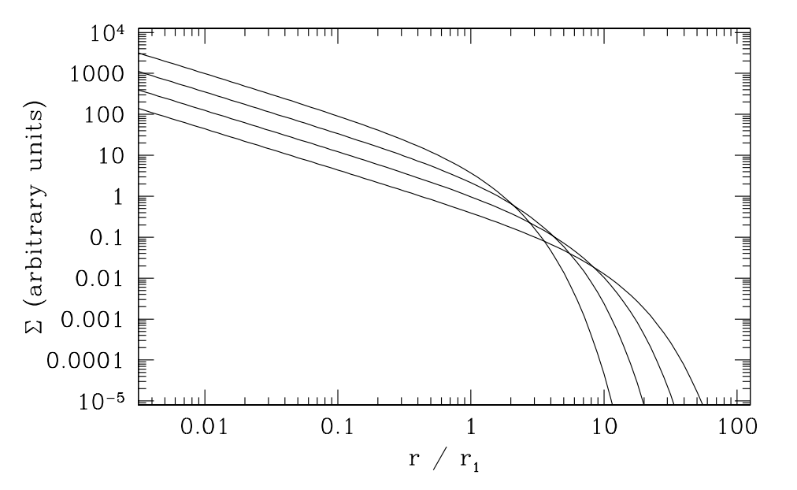
Gas disk accretes onto the central star
alpha-disk prescription: ν = α c_{s} H
Armitage 2009

Slide 27
Understand how radial drift and gas accretion affect snowline locations, and thus the C/O ratio in gas and dust throughout the disk
GOAL
Add Nitrogen in the chemical and dynamical framework and explore its effects and the N/O ratio

Slide 28
Nitrogen Abundance
Nitrogen is abundant in the Solar System and in disks, but its dominant form is largely unknown
Primarily found as N₂, but ~10% of nitrogen abundance may be carried by NH₃ (e.g., Lahuis & van Dishoeck 2000)
Can use abundance patterns both from the Solar System and from disk chemistry models (e.g., Schwarz & Bergin 2014) to define the range of abundance of different nitrogen carriers

Slide 29
Outline
The disk-planet connection
Previous Research: Minimum Core Masses for Planet Formation
Protoplanetary disk compositions
Proposed Research
Radial drift of solids, snowline locations and C/O ratios
Chemical effects
4. Preliminary Results
5. Proposed Completion Timeline

Slide 30
Gas-grain chemistry in disks is complex and evolves with time
Previous studies (e.g., Henning & Semenov 2013) have shown that disk chemistry is mostly regulated by disk temperature, density, stellar / interstellar radiation fields, and cosmic rays
In the inner disk, chemistry approaches equilibrium due to intense sources of ionizing radiation (e.g., Ilgner+04)
In the outer disk, high-energy radiation and cosmic rays are key drivers of the chemistry (e.g., van Dishoeck 2006) and chemistry is no longer in equilibrium
Most chemical evolution models are decoupled from disk dynamics

Slide 31
GOAL
Parametrize the detailed, time-dependent chemical reaction network developed by Merchantz et al. (in prep.) and use it in the radial drift calculation

Slide 32
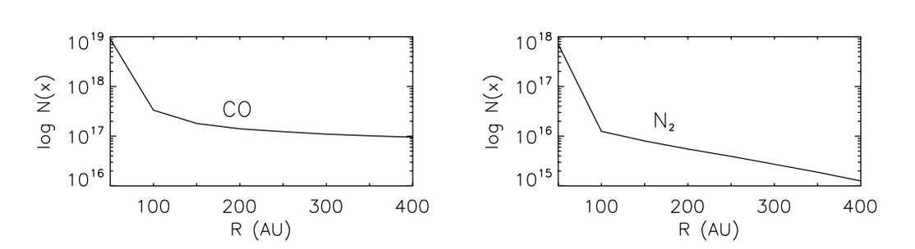
Parametrization of disk chemistry is possible
Willacy 2007

Slide 33
GOAL
Parametrize the detailed, time-dependent chemical reaction network developed by Merchantz et al. (in prep.) and use it in the radial drift calculation
Self-consistently evolve this chemical model and the disk dynamics

Slide 34
Outline
The disk-planet connection
Previous Research: Minimum Core Masses for Planet Formation
Protoplanetary disk compositions
Proposed Research
Radial drift of solids, snowline locations and C/O ratios
Chemical effects
4. Preliminary Results
5. Proposed Completion Timeline

Slide 35
Timescales for desorption, radial drift and gas accretion ARE comparable

Slide 36
Radial drift affects snowline location

Slide 37
Analytic estimates and numerical results are in good agreement

Slide 38
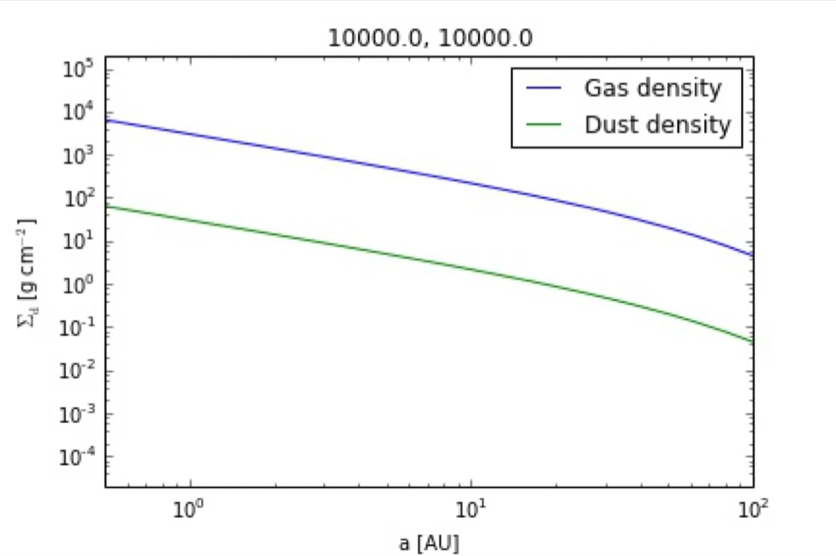
Determined profiles for gas and dust surface densities
s = 0.001 cm
alpha = 0.01, s = 0.001 cm

Slide 39
Determined profiles for gas and dust surface densities
s = 0.001 cm
alpha = 0.01, s = 1 km

Slide 40
Determined profiles for gas and dust surface densities
s = 0.001 cm
alpha = 0.01, s = 1 km
alpha = 0.01, s = 1 m

Slide 41
Next steps to completion
Trace the abundance of H2O, CO2 and CO in gaseous and solid form as the disk evolves
Basic idea: treat each species in gaseous and solid form as two fluids that are interchanging and use advection-like equations to solve for their separate time-dependent abundance
Will collaborate closely with Til Birnstiel for the numerical solver
From these abundances, calculate C/O ratio throughout the disk as a function of time and particle size

Slide 42
Outline
The disk-planet connection
Previous Research: Minimum Core Masses for Planet Formation
Protoplanetary disk compositions
Proposed Research
Radial drift of solids, snowline locations and C/O ratios
Chemical effects
4. Preliminary Results
5. Proposed Completion Timeline

Slide 43
Thesis Timeline
Paper I: “C/O IN PROTOPLANETARY DISKS: THE EFFECT OF RADIAL DRIFT AND VISCOUS ACCRETION”. Estimated completion spring 2015
Paper II: “N/O IN PROTOPLANETARY DISKS: THE EFFECT OF RADIAL DRIFT AND VISCOUS ACCRETION”. Estimated completion summer 2015
Paper III: Chemical evolution incorporated in radial drift model. Estimated completion fall 2015
Paper IV: Self-consistently evolve chemical model from Paper III and disk dynamics. Estimated completion spring 2016
Overall goal: complete thesis and graduate in spring 2016

Slide 45
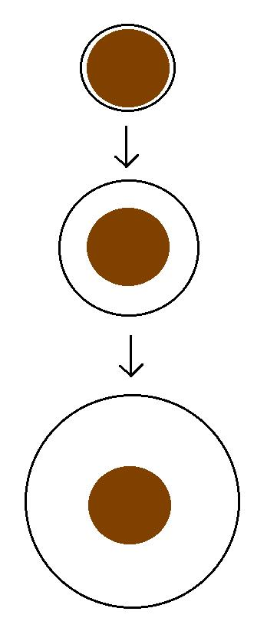
Kelvin-Helmholtz contraction
M_{atm} is a function of time
=> EVERY core can have
M_{atm} ~ M_{core}
“critical core mass”
M_{crit} = M_{core} for which
M_{atm}(t_{disk}) ~ M_{core}
M_{atm}(t₁)
M_{core}
M_{atm}(t₂)
M_{core}
M_{atm}(t₃) ~ M_{core}
M_{core}
Notes:
So in this regime, there is no longer a steady state, but rather the atmosphere mass is a function of time; now core growth is negligible; so you start with a small atmosphere that gradually grows until it become comparable to the core mass; so in this scenario, every core can have an atmosphere equal to its own and become critical

Slide 46
Model Assumptions
Negligible planetesimal accretion => solid core of fixed mass M_{c}
Atmosphere is embedded in the gas disk, spherically symmetric and in hydrostatic balance
Two layer atmosphere: inner convective region and outer radiative region
Constant luminosity throughout the radiative region
see Piso & Youdin (2014) for details

Slide 47
Static profiles connected by global cooling equation
CONVECTIVE
RADIATIVE
L ~ -dE/dt
a = 10 AU, M_{c} = 5 M_{E}
Adiabatic gradient relates P, T, rho => determines atmospheric profile and parametrizes EOS
a = 10 AU, M_{c} = 5 M_{E}

Slide 48
Adiabatic gradient is variable for realistic EOS
Piso, Youdin, & Murray-Clay (2015)

Slide 49
Adiabatic gradient is variable for realistic EOS
Saumon+95
Piso, Youdin, & Murray-Clay (2015)
Our extension

Slide 50
Adiabatic gradient is variable for realistic EOS
Piso, Youdin, & Murray-Clay (2015)
H2 dissociation
H ionization
Ideal gas

Slide 51
Adiabatic gradient is variable for realistic EOS
Piso, Youdin, & Murray-Clay (2015)
Partially excited H₂ rotational states

Slide 52
Adiabatic gradient is variable for realistic EOS
H₂ spin isomers ORTHOHYDROGEN and PARAHYDROGEN can be in thermal equilibrium or fixed ratio
Piso, Youdin, & Murray-Clay (2015)
Ortho-para equilibrium
Fixed 3:1 ortho-to-para ratio
Partially excited H₂ rotational states

